Slide 1



lrd: An R Package and Shiny Application for Quickly Processing Lexical Response Data
Nicholas P. Maxwell¹, Mark J. Huff¹, & Erin M. Buchanan²
nicholas.maxwell@usm.edu | https://osf.io/admyx/

Slide 2
Introduction
Recall testing is commonly used to gauge memory retrieval
Coding responses can be time intensive and error prone
lrd (Lexical Response Data) is designed automate scoring of recall data
Cued-recall
Free recall
Sentence responses

Slide 3
Overview of Package
Three core functions:
prop_correct_cued()
prop_correct_free()
prop_correct_sentence()
Also includes several plotting functions:
Serial position curves, probability of first response, conditional response probabilities
Available at: https://github.com/npm27/lrd -- CRAN release coming soon!
To install: devtools::install_github(“npm27/lrd”)

Slide 4
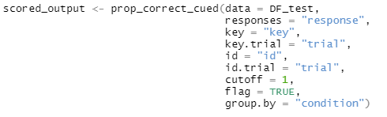
Cued-Recall
prop_correct_cued()
Response column

Slide 5
Cued-Recall
prop_correct_cued()
Response column
Answer key column

Slide 6
Cued-Recall
prop_correct_cued()
Response column
Answer key column
Item number for answer key

Slide 7
Cued-Recall
prop_correct_cued()
Response column
Answer key column
Item number for answer key
Participant Identifier

Slide 8
Cued-Recall
prop_correct_cued()
Response column
Answer key column
Item number for answer key
Participant Identifier
Item number for study pairs

Slide 9
Cued-Recall
prop_correct_cued()
Response column
Answer key column
Item number for answer key
Participant Identifier
Item number for study pairs
Levenshtein Distance for scoring

Slide 10
Cued-Recall
prop_correct_cued()
Response column
Answer key column
Item number for answer key
Participant Identifier
Item number for study pairs
Levenshtein Distance for scoring
Flag Outliers? (± 3 sd)

Slide 11
Cued-Recall
prop_correct_cued()
Response column
Answer key column
Item number for answer key
Participant Identifier
Item number for study pairs
Levenshtein Distance for scoring
Flag Outliers? (± 3 sd)
Should output be grouped by condition?

Slide 12
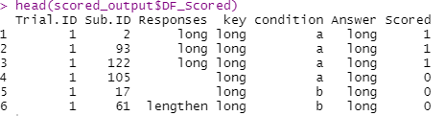
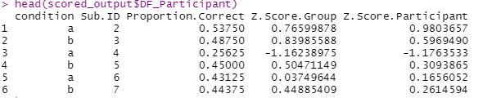
Cued-Recall
prop_correct_cued()

Slide 13
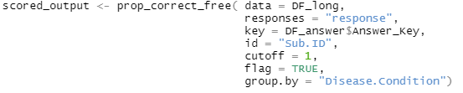
Free Recall
prop_correct_free()
Note: Data will need to be in long format!
Can use arrange_data() function to quickly convert free recall data from wide to long format!

Slide 14
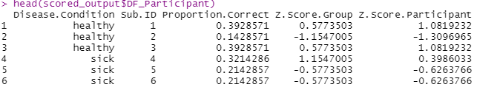
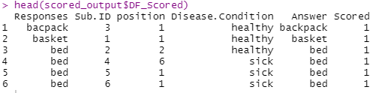
Free Recall
prop_correct_free()

Slide 15
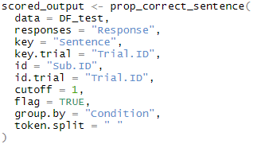
Sentences
prop_correct_sentence()
What separates words in each sentence?

Slide 16
Sentences
prop_correct_sentence()

Slide 17
Sentences
prop_correct_sentence()

Slide 18
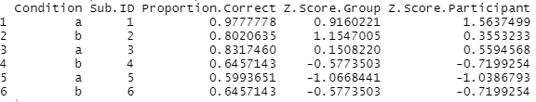
Sentences
prop_correct_sentence()

Slide 19
lrd Shiny Application
lrd is also available as an R Shiny application!
https://github.com/npm27/lrd/

Slide 20
Summary
lrd allows researchers to quickly score several types of recall data
The goal is to provide a standardized, open-source method for processing lexical output across psychological studies.

Slide 21
Questions?

